Slide 1
Cluster and Network Policy in Germany Gerd Meier zu Köcker iit – Institute for Innovation and Technology
October 9th, 2012

Slide 2
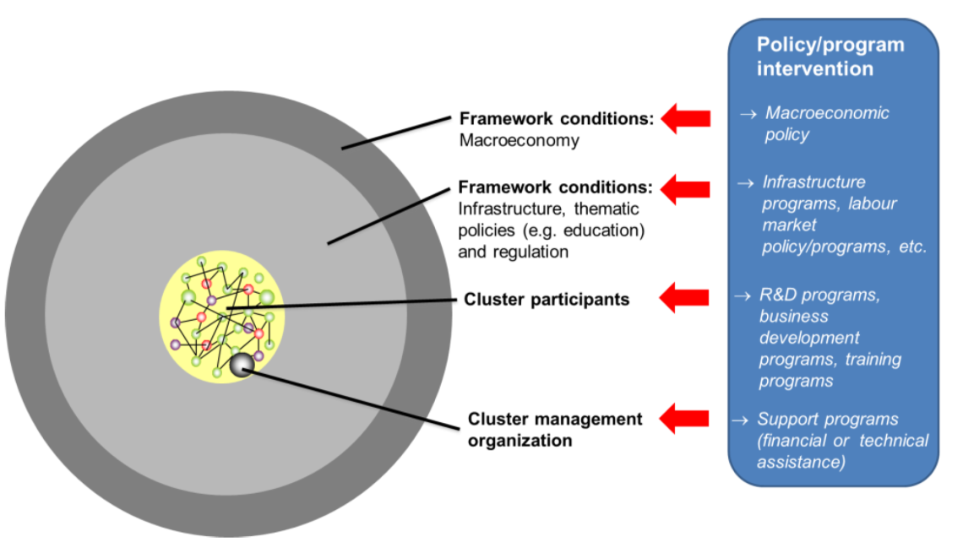
Levels of Policy Intervention

Slide 3
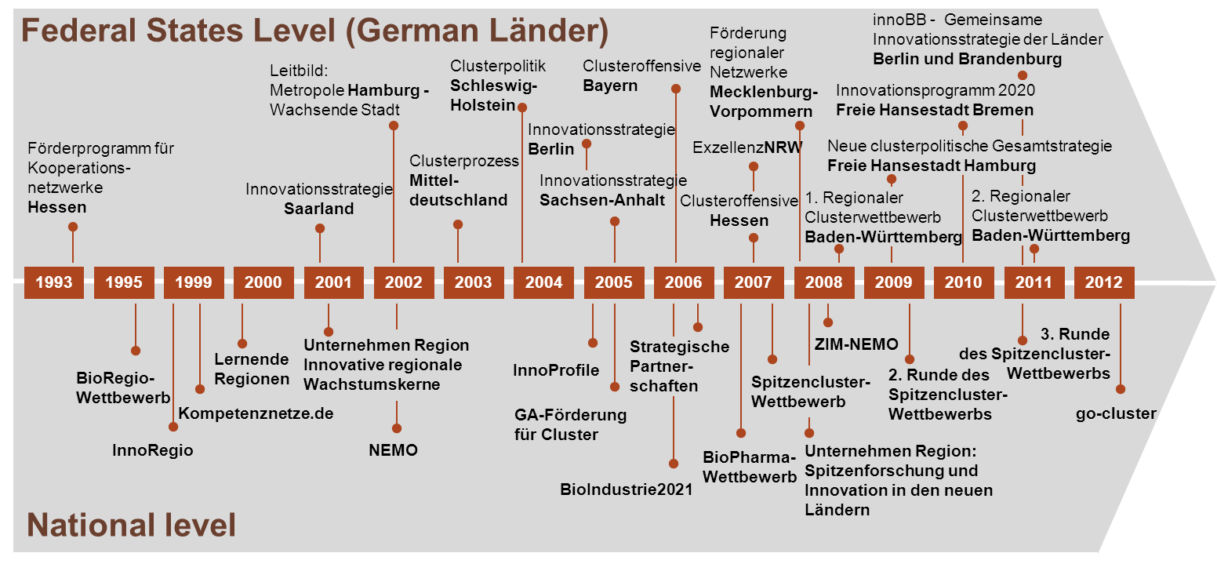
Cluster Support Schemes in Germany

Slide 4
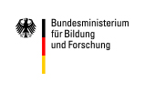
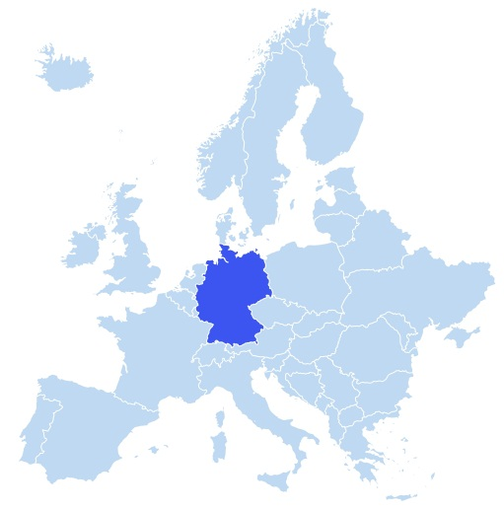
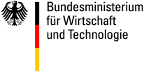
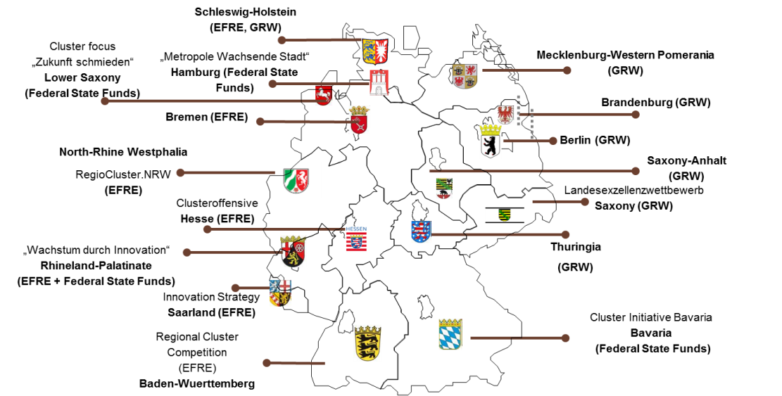
Each Federal State Has its Own Funding Schemes…..
Support to cluster management organisations
Support to cluster actors
Federal
Government
Federal State
Governments
Seite 4

Slide 5
.. but Similar Objectives
Intensification of cooperation between science, research and business in order to generate added value along the entire value creation
Long-term sustained development of competitive and rapidly growing regions
Location marketing – highlighting of individual strengths and potentials and thus also of
Increase in training capacities and creating stronger links between qualified skilled staff and the specific region (keeping them in the region)
Strengthening of entrepreneurial spirit and the establishment of businesses,
Network and cluster policies as a measure for enhancing networking between companies as well as R&D institutions,
Network and cluster policies as a means of promoting economic development and structural change

Slide 6
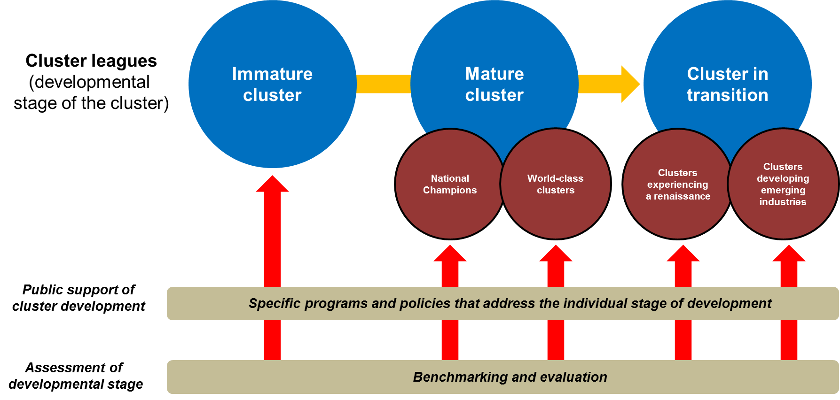
Cluster Programs on Federal Aims to Different Cluster Leagues

Slide 7
Key Determinants for Excellent Clusters
Continuous improvement
Technology area of the cluster
Structure
Size and composition of members
Age
Governance
Sustainibility of financing
Spectrum and quality
of the tailor-made
services provided by
the cluster management
organisation
Impact on the
activities of the
members
Strategy
Industry or research driven
Reputation and Visibility
Number of cooperation requests
Marketing, Success Stories
National and international visibility
Source: NGPExcellence 2011

Slide 8
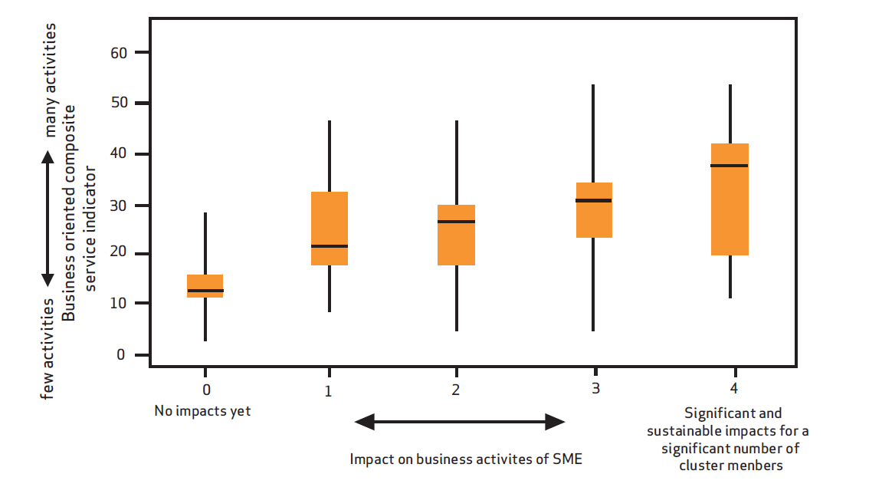
Cluster Management Excellence as Key Success Factor
Source: Lämmer-Gamp, Meier zu Köcker, Christensen, Clusters are Individuals, 2011

Slide 9
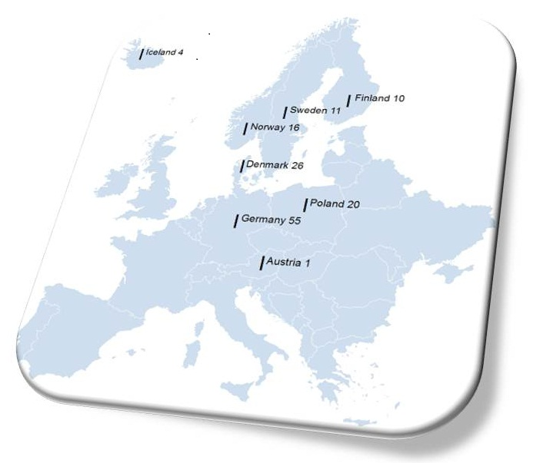
The NGPExcellence Project – Cluster Excellence in the Nordic Countries Transnational cluster policy cooperation
Benchmarking of 143 cluster
management organizations from
eight countries
Benchmarking of 16 cluster
programs from nine countries
www.clusterexcellence.org

Slide 10
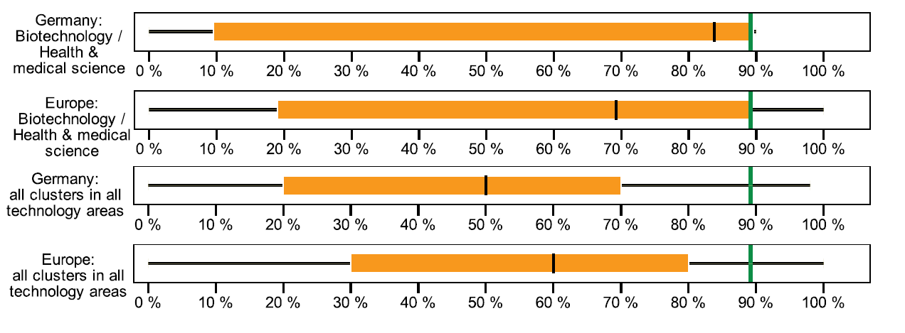
Share of Public Funding of the Cluster Organisation
Source: NGPExcellence 2011

Slide 11
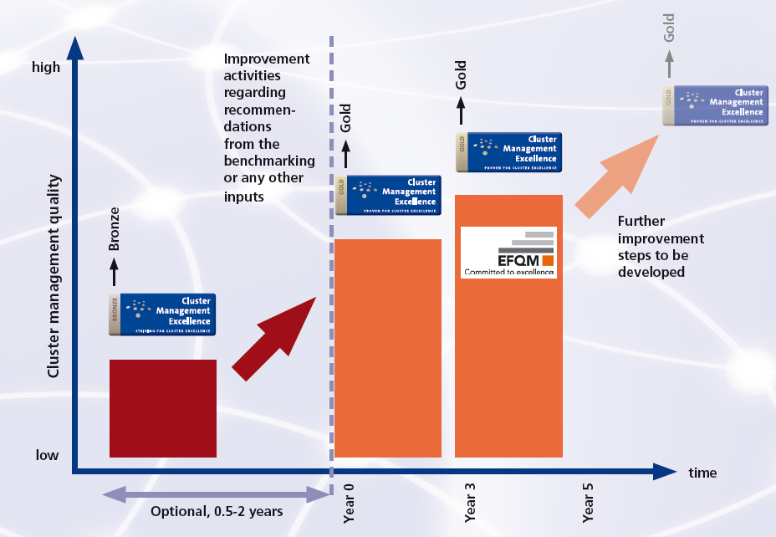
Trends in Cluster Policy: Striving for Cluster Management Excellence in Europe

Slide 12
Key Elements of the New German Cluster Excellence Support Scheme
Module 1
Networking
Analysis cluster-political trends
Cooperation cluster programmes
Interlinking measures BMWi
Public Relations
Module 2
Cluster platform
Implementation Cluster platform
Development Evaluation instrument
Admission
Implementation dialogue between Federal Governement and states
Module 3
Impulses of Excellence
Competition according to ECEI
Development of perfectly fitting Services
Implementation exchange of experiences
Identification of innovation clusters
Module 4
Support
Funding of new cluster services

Slide 13
Cluster Policy Recommendations for a Better Cluster Policy in Europe
Coordination and linkages between cluster programs and other innovation support program are a key success factor
Tailor-made assistance should have a high relevance in the program strategy
Programs should put emphasis on cluster management excellence
Cluster programs should develop world-class clusters in industry sectors that are internationally competitive
Long-term, but flexible support of clusters is required
Monitoring and evaluation of results and impacts of a program is important and should be done in a smart and purposeful manner
Clusters from different industrial sectors need different support schemes

